Slide 1
Electrical Impedance Tomography
Identifying tumours (or defective regions) in
human body using Machine Learning

Slide 2
Idealogy
Human body has electrical properties
Surface electrodes are attached to the skin around the body part
Small alternating currents will be applied to the electrodes
Impedance is measured across electrodes

Slide 3
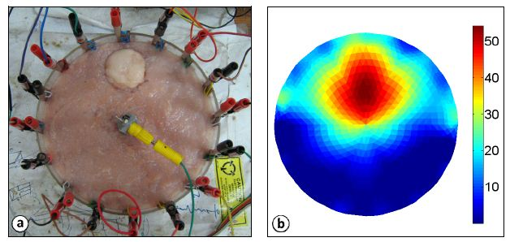
Sample Image of an EIT

Slide 4
Methodology
Sample image is imported using OpenCV and is converted into a 2D Matrix
To simplify the process, it is converted to grayscale
Each value in the matrix represents intensities of either black or white (0 being black and 1 being white)
Impedance is measured across electrodes

Slide 5
Image generation
numpy – random number generator, linespace and meshgrid
1000 random-related images are created based on the matrices and its values
The generated images are read back into code
Images are plotted to observe the distribution of intensities

Slide 6
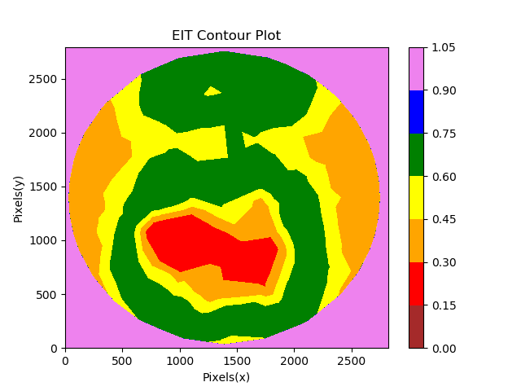
Sample Image Generated
The range of values are assigned colour only for the purpose of representation
Originally, the image is still grayscale
The red region is considered affected

Slide 7
Image generation - Target
Mean intensity ranges are calculated and are assigned labels (colours) correspondingly
A dataset of 8 intensity ranges (columns) and 1000 values (rows) are created
Binary targets are generated and are appended to the existing dataset as a target column
If the pixel count is more than the mean, the image is categorised as ‘1’
If the pixel count is less than the mean, the image is categorised as ‘0’

Slide 8
Machine Learning
Data attributes with pixel counts greater than zero are selected as features
Data is split into training and test sets and the model is trained on the training set
Performance of various classification algorithms are measured using cross-validation

Slide 9
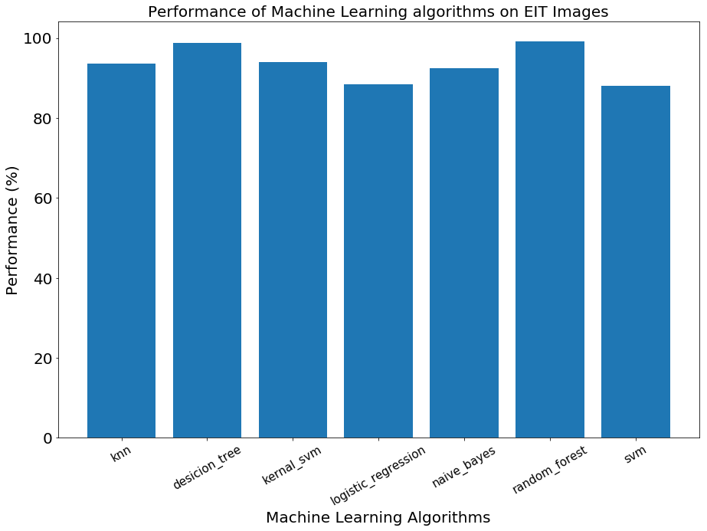
Results
No | Algorithms | Algorithms’ accuracy
1 | K Nearest Neighbours | 93.6%
2 | Decision Tree Classification | 98.8%
3 | Kernel Support Vector Machines | 94%
4 | Logistic Regression | 88.4%
5 | Naive Bayes | 92.4%
6 | Random Forest Classification | 99.2%
7 | Support Vector Machines | 88%

